Slide 1

Blockchain course A HIGH-LEVEL OVERVIEW
Dr. Norbert Oláh

Slide 2

Table of Contents
Blockchain course information
What is Blockchain?
Distributed Systems
The history of blockchain and Bitcoin
Consensus

Slide 3
Syllabus part 1
Week 1: Blockchain: A High-Level Overview
Week 2: Beginning of Blockchain: History and the Bitcoin
Week 3: Bitcoin Mechanics and Optimizations: Cryptography Overview Part 1
Week 4: Bitcoin Mechanics and Optimizations: Cryptography Overview Part 2
Week 5: Interacting with Bitcoin: Wallets, Mining, and More Part 1
Week 6: Interacting with Bitcoin: Wallets, Mining, and More Part 2

Slide 4
Syllabus part 2
Week 7: Security of Bitcoin: Game Theory and Attacks
Week 8: Trust without Trust: Distributed Systems & Consensus Part 1
Week 9: Trust without Trust: Distributed Systems & Consensus Part 2
Week 10: Ethereum and Smart Contracts: Enabling a Decentralized Future
Week 11: Conclusions: A Blockchain-Powered Future
Week 12: Pre-test possibility

Slide 5
Requirements
Final test
At the end of the semester, the students will have to answer theoretical questions. The exam is successful if the student achieves at least 50% of the points.
Final test structure:
multiple-choice question (25 questions – 25 points)
Short answer question (5 questions – 10 points)
Participation (10 points)
Research readings and project (5 extra points)
Professional days (3 extra points)
Point | Grade
39-45 | 5
33-38 | 4
27-32 | 3
21-26 | 2
20 and less | 1

Slide 6
What is Blockchain?

Slide 7
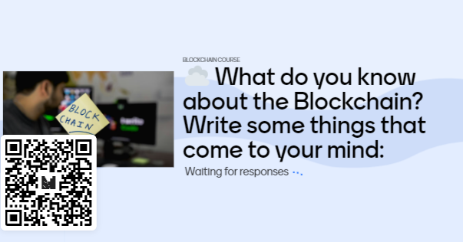
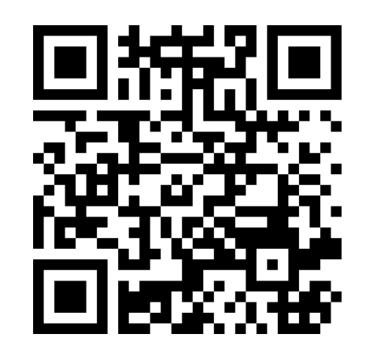
What do you know about the Blockchain? Write some things that come to your mind:
https://www.menti.com/al6h2kqda6zg

Slide 8
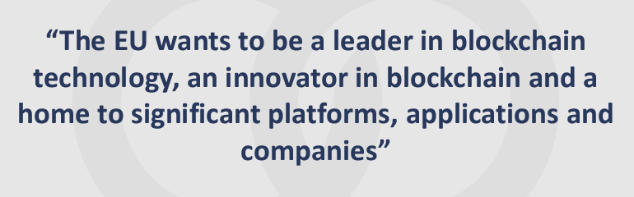
Increasing interest

Slide 9
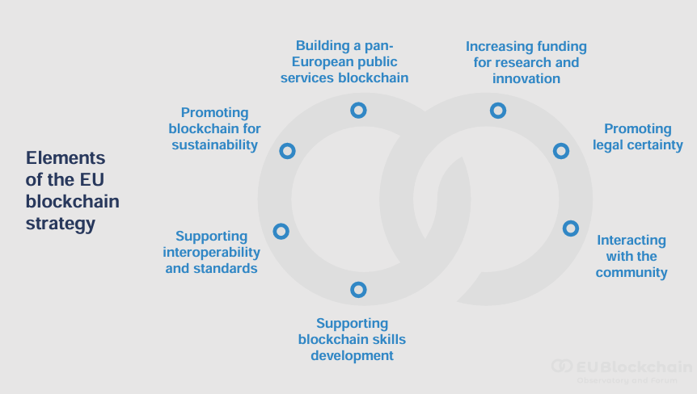
Increasing interest

Slide 10
Basic concepts and definitions

Slide 11
Distributed systems
What is Blockchain?
Two or more nodes work with each other in a coordinated fashion to achieve a common outcome.
A node can be defined as an individual player in a distributed system:
Capable of sending and receiving messages
It can be honest, faulty, or malicious (Byzantine nodes can be intentionally malicious)
It has memory and a processor.
The primary challenge of a distributed system design is the coordination between nodes and fault tolerance.
Notes:
For example, Google's search engine is based on a large distributed system; however, to a user, it looks like a single, coherent platform.

Slide 12
Definitions
What is Blockchain?
Cryptocurrency: A form of currency that’s stored completely digitally, and isn’t issued by a central authority. Made secure with cryptography, distributed consensus, and economic incentive alignment.
Bitcoin is a cryptocurrency.
Blockchain: The data structure used to represent a cryptocurrency. Stores data in a way that allows multiple parties to access it reliably without having to trust one another.

Slide 13
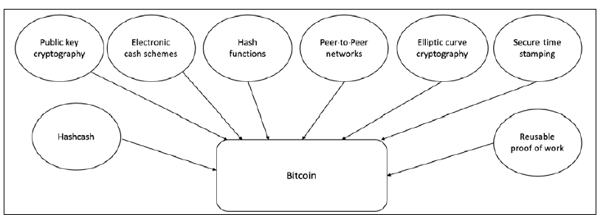
What is Blockchain?

Slide 14
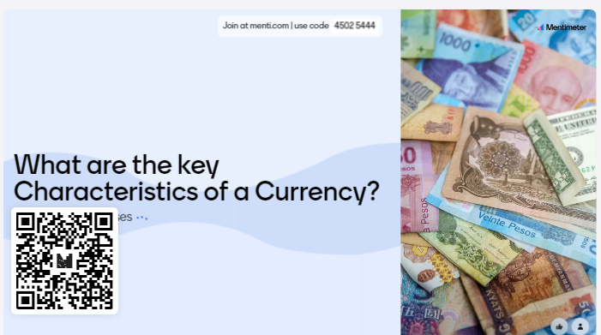
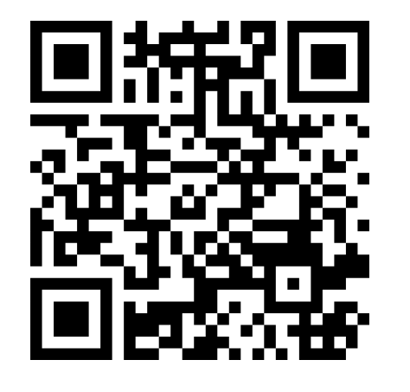
What are the key Characteristics of a Currency?
CODE: 4502 5444
https://www.menti.com/al6h2kqda6zg

Slide 15
Key Characteristics of a Currency
What is Blockchain?
Durability: The currency does not lose value and is not destroyed or made irredeemable easily.
Portability: The currency is easy to transport from place to place.
Divisibility: The currency can be easily exchanged in different denominations.
Uniformity: All units of the currency are identical in value.
Limited supply: The supply of the currency can’t be arbitrarily inflated.
Acceptability: The currency must be sufficiently widely accepted.

Slide 16
Electronic cash
What is Blockchain?
Two fundamental e-cash system issues need to be addressed:
Accountability: It is required to ensure that cash is spendable only once (addressing the double-spending problem) and that it can only be spent by its rightful owner.
Anonymity is required to protect users' privacy.
Notes:
The double-spending problem arises when the same money can be spent twice. As it is quite easy to make copies of digital data, this becomes a big issue in digital currencies as you can make many copies of the same amount of digital cash.
With physical cash, it is almost impossible to trace back spending to the individual who actually paid the money, which provides adequate privacy should the consumer choose to hide their identity.

Slide 17
Blockchain definition
What is Blockchain?
Layman's definition: Blockchain is an ever-growing, secure, shared recordkeeping system in which each user of the data holds a copy of the records, which can only be updated if all parties involved in a transaction agree to update.
Technical definition: Blockchain is a peer-to-peer, distributed ledger that is cryptographically secure, append-only, immutable (extremely hard to change), and updateable only via consensus or agreement among peers.

Slide 18
Keywords from the technical definition
What is Blockchain?
Peer-to-peer
This means that there is no central controller in the network, and all participants (nodes) talk to each other directly.
This property allows for transactions to be conducted directly among the peers without third-party involvement, such as by a bank.

Slide 19
Keywords from the technical definition
What is Blockchain?
Distributed ledger
„Distributed ledger” means that a ledger is spread across the network among all peers in the network, and each peer holds a copy of the complete ledger.

Slide 20
Keywords from the technical definition
What is Blockchain?
Cryptographically secure
„Cryptographically secure" means that cryptography has been used to provide security services that make this ledger secure against tampering and misuse.
These services include non-repudiation, data integrity, and data origin authentication.

Slide 21
Keywords from the technical definition
What is Blockchain?
Append-only
„Append-only" means that data can only be added to the blockchain in time-sequential order.
This property implies that once data is added to the blockchain, it is almost impossible to change that data and it can be considered practically immutable.
In other words, blocks added to the blockchain cannot be changed, which allows blockchain to become an immutable and tamper-proof ledger of transactions.
Question: Generally, What other operations can you do?

Slide 22
Keywords from the technical definition
What is Blockchain?
Updatable via consensus
No central authority is in control of updating the ledger.
Any update made to the blockchain is validated against strict criteria defined by the blockchain protocol and added to the blockchain only after a consensus has been reached among all participating peers/nodes on the network.
To achieve consensus, there are various consensus facilitation algorithms that ensure all parties agree on the final state of the data on the blockchain network and resolutely agree upon it to be true.

Slide 23
What is Centralization?
What is Blockchain?
Authorization handled by a single party
Data is stored by a single party
Think:
Client-server networking
Hierarchical org chart
Political dynasty
Central bank
Figurehead
}
}
}
Notes:
Centralization is a system where there all decisions regarding authorization and what the state of the system is, as well as all storage of data and assets are managed by a single, central authority.
This allows for Censorship, as well as a central point of failure.
Ok so what does this mean, I just said a lot of things about centralizations. Let’s take a look at an example from the financial world since we’re going to be looking at bitcoin today.
Look at the way credit card companies or banks operate.
All data is controlled by single entity. That is visa or Bofa or whatever.
During normal transactions usually a bank or credit card company will be the one authorizing it. And the state of the system is also managed by the bank.
What does state of the system mean? In financial systems this usually refers to how much money each person has. Say for example you have a bank with 3 accounts, it can be in many different states A can have 100 B can have 200 C can have 300 ---> or A can have …..
The state that the system is in is managed by the bank.
Now i also mentioned censorship, and a central point of failure
Censorship → talk about facebook a centralized application, having complete control over what goes on in the network → censoring conservative media like in the first picture
Central point of failure → Many bank hacks for example Capital One hack where millions of users data got compromised, including many social security numbers
Talk about the picture of them greek man → Greek debt crisis → Banks had to close up and didn’t let people collect money that they needed that was rightfully theirs

Slide 24
What is Blockchain?
Centralization Pros & Cons
Pros
Cons
01
Efficiency
01
Lack of sovereignty
Data is stored in one place, programs are executed once
A central party may choose to use your data arbitrarily
02
Easy updates
One point of failure
02
Updates need one stamp of approval and can be force-pushed to users
Any hack, attack, or failure only has to happen in one place

Slide 25
What is Blockchain?
What is decentralization?
Authorization according to an openly-known protocol
Data is stored by the participants
Think:
Peer-to-peer networking
Flat org chart
Pure democracy
Barter economy
Community
Notes:
Ok now that we have a stronger understanding of what centralization is, lets look at decentralization.
Decentralization involves the delegation and distribution of data storage, verification, decisions on state of system to everyone.
What does this mean? It means that there is no longer one central entity that has control over what transactions are good and what transactions aren’t good and no central authority decides what the state of the system is.
This means that we have to figure out a way for all node to come to consensus → we will go through this in more detail later in this lecture and throughout the course, so for now just understand that in order for stuff to be decentralized, people need to come to a consensus.

Slide 26
What is Blockchain?
Decentralization Pros & Cons
Pros
Cons
01
Sovereignty
01
Inefficiency
You know exactly how your data will be used
Data is duplicated and programs are re-executed across the network
02
Fault tolerance
Difficult updates
02
The whole network has to get taken down, rather than a single party
Updates must be deliberately adopted by participants in the network

Slide 27
Cryptocurrency vs. currency

Slide 28
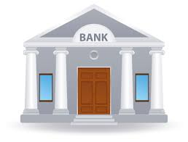
CURRENCY
“IN BANKS WE DISTRUST”
Identity Management
Storage for your personal information and account balances
Services
Transferring and Redeeming Money
Record Management
Tracking account history, particularly for audits
Trust
Verified professionals regulated by government
How do we make a decentralized system that does everything that a bank does?

Slide 29

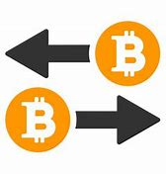
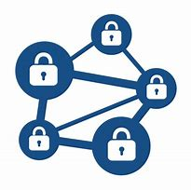

CRIPTOCURRENCY
BITCOIN COMPONENTS
Identity Management
Addresses/accounts that can contain, send, and receive bitcoin
Transactions
The ability to send and receive bitcoin securely
Distributed Ledger
Records of bitcoin transfers are maintained across the network
Trustless Consensus
Alignment of community goals with personal incentives

Slide 30
Identity

Slide 31
Identity
Leading Question
“What makes an identity yours?”

Slide 32
Identity
Identity at the Bank
Username and password are issued by central manager
The bank makes sure usernames are unique
Identity is confirmed through personal information
Social Security Number
Name
Birthdate
Address

Slide 33
Identity
Identity In Currencies
What’s the role of identity in the context of currencies?
Receiving money
Claiming/spending money
Blame – tracking the money
Identity in daily life:
Houses have addresses and mailbox keys
Emails have aliases and passwords
Bitcoin has public keys and private keys
Notes:
Authentication vs Blaming
Can’t undo signature (non-repudiable)
Can’t retrieve private key once lost
Integrity: Can be sure that no one can intercept and modify, tamper-evident
Authentication: “You don’t want anyone else receiving, claiming, or spending your money. For your protection, currencies require authentication to ensure that you and you alone have control of your assets.”
Blame: We want to be able to know which account spent how much money - we want to be able to agree on what has happened in the past and be able to prove that a certain account did something

Slide 34
Transactions

Slide 35
Transactions
Leading Question
“What makes a transaction valid?”
Notes:
Discussion: get some answers called out
Medium of transaction must be valid/have value
Good storage of value over time, stable medium of exchange (don’t want the price to inflate/deflate quickly in a short amount)
Identify who is giving, who is receiving
Need to be trustworthy: make sure that no one is using funds 2 times, no one can pay someone else and still keep the same amount of funds

Slide 36
Transactions
Validity
Proof of ownership
Available funds
No other transactions using the same funds
Notes:
Easy to identify first bullet -- just need private key
For second and third bullet, intuitive to keep track of with accounts but actually reasonably difficult memory-wise and security-wise
Easier to merely keep track of transaction inputs and outputs without summing up into an account

Slide 37
Transactions
Traditional Model
Central manager keeps track of account balances and verifies that transactions are valid
Each account has an available balance
To spend, money is subtracted from the total
To receive, money it is added to the total
Alice
Bob
$100
$250
Balance:
Balance:
-$10
-$10

Slide 38
Distributed Ledger

Slide 39
Distributed Ledger
Record-Keeping: Traditional Model
Data is stored and updated by one central entity
Security measures in place to prevent hackers and failure
“Ok, fine.”
Alice -> Bob, $3
“Can I send $3 to Bob?”
+$3
Alice
Bob
Notes:
In a bank, there is some kind of central database that has security measures to keep hackers from changing things. There might be multiple copies in case their server goes down, but what we know is that the bank alone holds our data. If we disagree with the data we see, we have to take it up with the bank because their record is THE record.

Slide 40
RECORD-KEEPING
DISTRIBUTED DATABASES
Sender | Recipient | Amount (BTC)
Justin | Oscar | 4
Justin | Justin | 1
Oscar | Rustie | 5
Oscar | Oscar | 1
Janice
Rustie
How do we store all these transactions?
⇒ With a distributed database
Satoshi
?
Justin
Oscar
Notes:
Okay, so say that we have a network of five people that are sending and receiving transactions from one another. Up on the upper right corner, we have a table representing the transactions that have occurred at some point in time. We don’t want to store these transactions in a centralized database because that’s not what this course is about, so what do we do? Put it in a distributed database, such as a blockchain. We want to be able to store this entire table in a singular block on the blockchain, and verify it somehow so that future transactions may be verified as well in a future block.
But we don’t want just one person to keep track of transactions, right? But who’s going to keep track of all the transactions that happened in the past? We also don’t want just a couple people in the network with access to this information, because that’s still somewhat centralized, as you’re trusting these few individuals with this history. So what do we do? Let everyone have a copy!

Slide 41
RECORD-KEEPING
EVERYONE’S THE BANK
Janice
Rustie
We compile transactions into blocks and store them in a blockchain
Everyone has a copy of the blockchain
Satoshi
Justin
Oscar
Notes:
To get as far as possible from having a central entity, we want everyone in a distributed system to be equally powerful - every person’s claim to the transaction history is equally legitimate, and there is no one person to bribe or hack to alter the database. That’s what we mean by no central point of failure.
We also don’t store every single transaction individually because that means every time a transaction is made, everyone’s database has to be updated at the same time. But it takes time for the information of a transaction to propagate throughout the system, b/c latency and other various factors, so we store the aggregate outcome of various transactions in a single block.

Slide 42
Trustless Consensus

Slide 43
Trustless Consensus
What is Consensus?
Consensus is the process by which a network’s participants come to agreement on some decision to be made.
In our case, agreeing on changes to a ledger of transactions.
Traditionally, very simple: we place 100% trust in the bank!

Slide 44
CONSENSUS
TRADITIONAL MODEL
Nadir
We all submit our transactions to a central authority who makes sure nobody double spends
Gillian
Nick
Gloria
Brian
Notes:
In our traditional bank model, it’s easy: the bank decides for us. It listens to what we want, makes sure it’s valid, approves it, and changes their records to reflect the new transaction.
Now, we want to do better than that and we want it to be decentralized.

Slide 45
CONSENSUS
STAYING ON THE SAME PAGE
Nadir
Everyone accepts valid transactions as they come around without “discussion”
Gillian
Nick
Gloria
Brian
Notes:
Let’s go with the naive approach first: every person can propose transactions freely, and save valid transactions they receive. If Gillian wants to send Brian 10 bitcoin, she can tell everyone to indicate this change in their personal record-book. Then make sure she has enough money in the UTXOs she’s spending, hasn’t already spent these UTXOs, and that she has a valid private key to sign off on these transactions. Then everyone goes ahead and updates their records.

Slide 46
CONSENSUS
DOUBLE SPEND ATTACK
Nadir
Gillian promises 10 BTC to Brian in one transaction, and she promises 10 BTC to Nadir in another
Gillian is performing a double spend attack
Gillian
Nick
Gloria
Brian
Notes:
But what if Gillian promises to send me a bitcoin and Brian the same bitcoin? She tells me she’s sending it to me, and tells Brian she’s sending it to him. At this point Brian and I own the “same” bitcoin, but neither of us will know until we try to spend it later and find out we have conflicting histories.

Slide 47
CONSENSUS
DOUBLE SPEND ATTACK
MALICIOUS ACTIVITY
Nadir
Gillian promises 10 BTC to Brian in one transaction, and she promises 10 BTC to Nadir in another
Gillian is performing a double spend attack
Gillian
Nick
Gloria
Brian
Notes:
What went wrong? We didn’t wait for confirmation from the rest of the network that this was a universally accepted truth.

Slide 48
CONSENSUS
PEER VALIDATION
Nadir
Instead of siloed decisions, let’s have proposers and voters
The proposer submits a transaction to everyone
Peers cast votes
Only save if received a certain number of votes
Gillian
Nick
Gloria
Brian
Notes:
So now we know that we need a way for everyone to be on the same page. Let’s set up a voting system where people propose transactions and the rest of the network votes on whether to accept it.

Slide 49
CONSENSUS
A STRANGER AMONG US
Nadir
Keep in mind, Bitcoin is an anonymous service with no central registry
Inexpensive to create multiple identities
Multiple identities ⇒ multiple opportunities to cast votes
Gillian
Nick Gillian
Gloria
Gillian
Brian

Slide 50
CONSENSUS
SYBIL ATTACK
MALICIOUS ACTIVITY
Nadir
Gillian can perform a Sybil attack, which will allow her to double spend
Gillian
Nick Gillian
Gloria Gillian
Brian
Notes:
This is called a Sybil Attack, where someone makes multiple entities to do something malicious. But really, What’s to stop her from doing this? What’s to stop anyone from doing this?
The word “Sybil” in the name comes from a case study about a woman named Sybil Dorsett, who was treated for Dissociative Identity Disorder – also called Multiple Personality Disorder.
Many blockchains use different “consensus algorithms” to help defend against Sybil attacks, such as Proof of Work, Proof of Stake, and Delegated Proof of Stake.
These consensus algorithms don’t actually prevent Sybil attacks, they just make it very impractical for an attacker to successfully carry out a Sybil attack.

Slide 51

CONSENSUS
PAY TO PLAY
Nadir
Proof of Work:
In order to propose a block, must include Proof-of-Work or the solution to a hash puzzle
Hash puzzle can only be solved using brute-force computation, which spends resources
People who create and propose blocks are called miners
Gillian
Notes:
Now we know we need to make it expensive to cast a vote; we need to expend something scarce in order to participate in the decision-making process. Satoshi Nakamoto recognized that we can prevent Sybil attacks by tying voting power not to identity but to resources - computational power. Enter Proof of Work: evidence of spent resources. In order to propose a block, you must provide proof of spent resources. The proof is a solution to a hash puzzle - which can only be solved through spending resources to brute force the solution. The hash puzzle solution is required to make a block valid.

Slide 52
CONSENSUS
PROOF-OF-WORK WORKS
Nadir
Gillian
Gillian has many identities but limited resources
Nick Gillian
Gloria Gillian
Brian
Notes:
Consider expense, or cost. The loss of some resource in order to achieve something goal. Since we need to make votes expensive to cast, we need to identify a resource to force others to spend. Satoshi realized that, to preserve freedom and anonymity while solving the issue of endless identities, each vote needs to be tethered to the individual’s computer. And what does a computer do best? It computes!
Satoshi defined a new protocol called “Proof-of-Work,” in which computers can only cast votes after performing an expensive amount of computing power. You might not realize, but every computer operation consumes energy and time, both of which are valuable resources. By forcing someone to consume these two things, you generate two results:
You prevent someone from using multiple identities to gain more power. They are limited by computing resources, not votes.
Every vote has value because resources were spent to achieve them. You can say that every vote is worth the amount of power that went into producing that vote, into solving that problem that was generated for that block at that round. Plus, instead of needing to have everyone vote on a given block, everyone can simply accept the vote cast for the block with the valid solution, or proof-of-work, for that problem.
For those who may be familiar a bit with the terminology, these validators are referred to as “miners.” Every time someone solves this problem, they’re given a reward in Bitcoin by everyone for expending computational resources. Naturally,

Slide 53
CONSENSUS
PROOF-OF-WORK WORKS
~no malicious activity~
Nadir
Gillian
Nick Gillian
Gloria Gillian
Brian
Notes:
Side note: to

Slide 54
Thank you for your attention!

